Slide 1
E-commerce website
By:
Megha
Greg

Slide 2
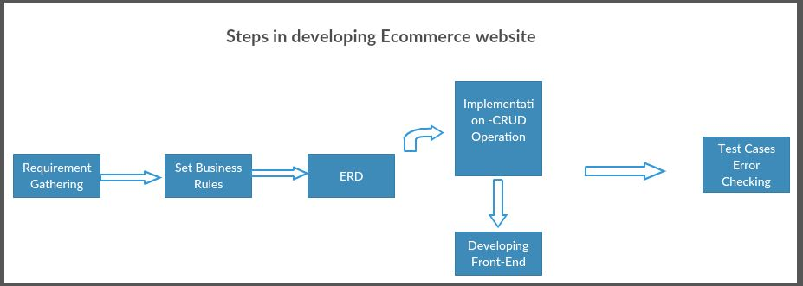
Outline of Team B project

Slide 3
UML Diagram
C:\Users\Sony\Desktop\team_b\UML diagram.pdf
Business Rules
Database design & business rules.docx
ER Diagram
C:\Users\Sony\Desktop\team_b\ecommerce_website.mwb
Tables
DDL_commands.sql

Slide 4
Checks Email exists-Procedure (1)
DROP PROCEDURE IF EXISTS checkEmailExists;
DELIMITER $$
CREATE PROCEDURE `checkEmailExists` (
IN user_name VARCHAR(25),
IN email VARCHAR(25),
IN phone_number VARCHAR(45),
IN gender VARCHAR(25),
IN pass VARCHAR(45),
IN street VARCHAR(45),
IN city VARCHAR(45),
IN zipcode INT,
IN state VARCHAR(45)
)
BEGIN
IF NOT EXISTS (SELECT * FROM team_b_db.user WHERE team_b_db.user.email = email ) THEN
BEGIN
INSERT INTO team_b_db.user(user_name, email, phone_number, gender, user_password, street, city, zipcode, state)
VALUES (user_name, email, phone_number, gender, pass, street, city, zipcode, state);
END;
ELSE
SELECT "0" AS result;
END IF;
END $$
DELIMITER ;

Slide 5
credentialsMatch-Procedure(2)
DROP PROCEDURE IF EXISTScredentialsMatch;
DELIMITER $$
CREATE PROCEDURE `credentialsMatch` (
IN email VARCHAR(25),
IN pass VARCHAR(45)
)
BEGIN
IF EXISTS (SELECT * FROM team_b_db.user WHERE team_b_db.user.email = email and
team_b_db.user.user_password = pass)
THEN
BEGIN
SELECT "Match" AS result;
END;
ELSE
SELECT "No Match" AS result;
END IF;
END $$
DELIMITER ;

Slide 6
CHANGE Password-Trigger
CREATE TABLE user_audit(
id int auto_increment primary key,
userID INT not null,
username VARCHAR(25) not null,
password varchar(30) not null,
changeDate DATETIME default null,
action varchar(20) default null
);

Slide 7
drop trigger before_user_update;
DELIMITER $$
CREATE TRIGGER before_user_update
BEFORE UPDATE ON USER
FOR EACH ROW
BEGIN
INSERT INTO user_audit
SET action = "update",
userID = OLD.user_id,
username = OLD.user_name,
password = OLD.user_password,
changeDate = NOW();
END $$
DELIMITER ;

Slide 8
updateUserPassword –Procedure(3)
DROP PROCEDURE IF EXISTS updateUserPassword;
DELIMITER $$
CREATE PROCEDURE `updateUserPassword` (
IN email VARCHAR(25),
IN pass VARCHAR(45)
)
BEGIN
IF EXISTS (SELECT * FROM user where user.email = email) THEN
BEGIN
SET @userId = (SELECT user_id FROM user WHERE user.email = email);
UPDATE user SET user_password = pass WHERE user.user_id= @userId;
SELECT "Updated" AS result;
END;
ELSE
SELECT "Not Updated" AS result;
END IF;
END $$
DELIMITER ;

Slide 9
InsertProduct-Procedure(4)
DROP PROCEDURE IF EXISTS team_b_db.insertProduct;
DELIMITER $$
CREATE PROCEDURE `insertProduct` (
IN productTitle VARCHAR(45),
IN price DECIMAL(5,2),
IN image LONGBLOB,
IN categoryId INT,
IN size ENUM('small', 'medium', 'large'),
IN quantity INT
)
BEGIN
IF EXISTS (SELECT * FROM team_b_db.product WHERE team_b_db.product.product_title = productTitle) THEN
BEGIN
SET @productId = (SELECT team_b_db.product.product_id FROM team_b_db.product WHERE team_b_db.product.product_title =
productTitle);
INSERT INTO team_b_db.quantity_size(size, quantity, product_product_id) VALUES (size, quantity, @productId);
END;
ELSE
BEGIN
INSERT INTO team_b_db.product(product_title,price, image, category_category_id) VALUES (productTitle, price, image, categoryId);
SET @productId = (SELECT team_b_db.product.product_id FROM team_b_db.product WHERE team_b_db.product.product_title =
productTitle);
INSERT INTO team_b_db.quantity_size(size, quantity, product_product_id) VALUES (size, quantity, @productId);
END;
END IF;
END $$
DELIMITER ;

Slide 10
Order Details- using join
SELECT team_b_db.order.order_id,
User_user_id,
team_b_db.order.product_product_id,
team_b_db.product.product_title,
size,
team_b_db.order.quantity,
purchase_date
FROM
team_b_db.order
INNER JOIN
team_b_db.quantity_size
ON team_b_db.order.product_product_id =
team_b_db.quantity_size.product_product_id
INNER JOIN
team_b_db.product
ON team_b_db.product.product_id = team_b_db.quantity_size.product_product_id;

Slide 11
deleteProduct-Procedure(5)
create definer = teamB@`%` procedure deleteProduct(IN product_id int) BEGIN delete from product where team_b_db.product.product_id=product_id; END;

Slide 12
updateProduct- Procedure(6)
create definer = teamB@`%` procedure updateProduct(
IN productId int,
IN productTitle varchar(45),
IN Pr decimal(5, 2), IN Im longblob, IN categoryId int, IN Si enum ('small', 'medium', 'large'), IN Qu int
) BEGIN IF EXISTS(select * from team_b_db.product where team_b_db.product.product_id = productId) THEN UPDATE team_b_db.product set team_b_db.product.product_title = productTitle, team_b_db.product.category_category_id = categoryId, team_b_db.product.price = Pr, team_b_db.product.image = Im where team_b_db.product.product_id = productId; UPDATE team_b_db.quantity_size set team_b_db.quantity_size.size = Si, team_b_db.quantity_size.quantity = Qu where team_b_db.quantity_size.product_product_id = productId; ELSE select 'error occured' as result; END IF; END;

Slide 13
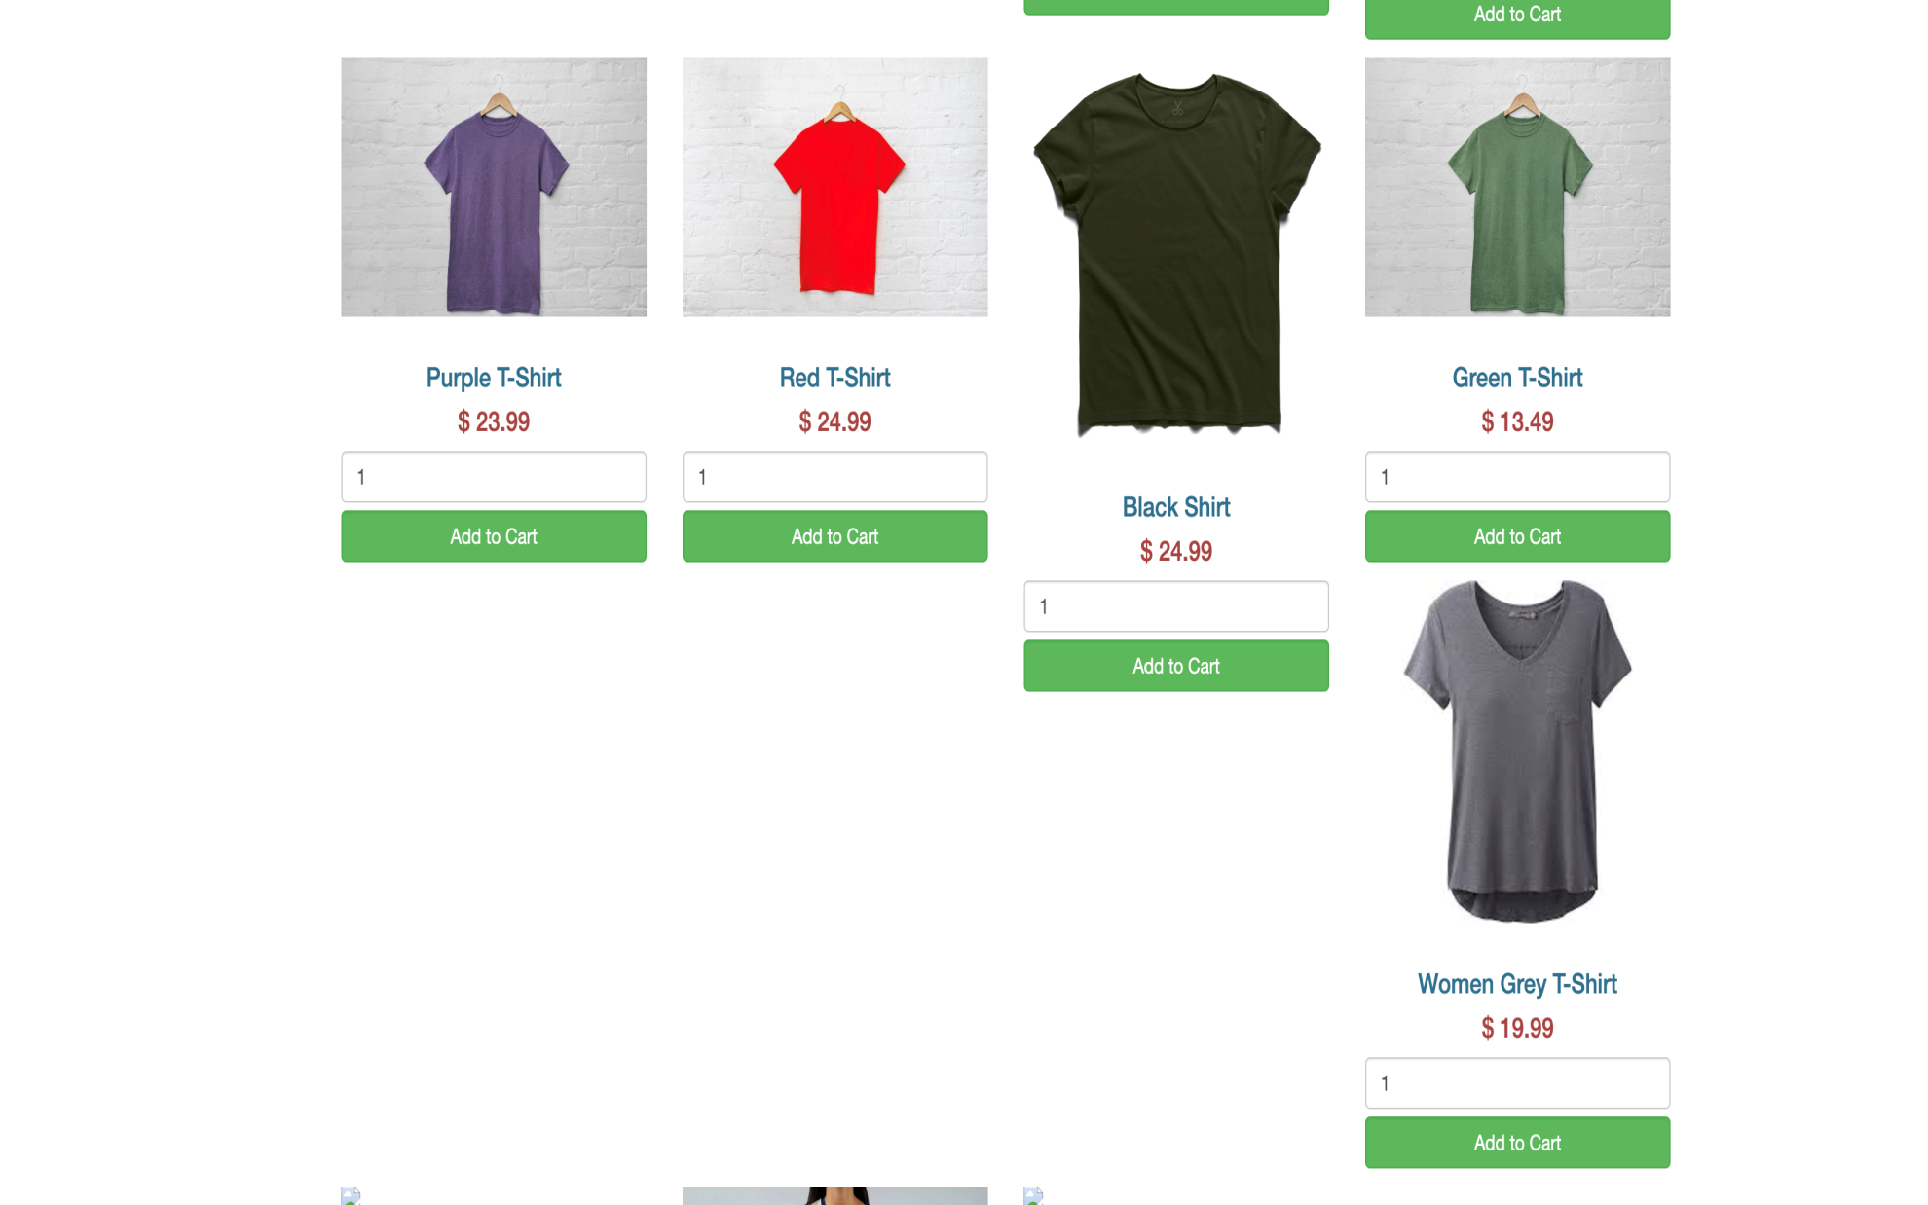
View Products Page:

Slide 14
